Slide 1
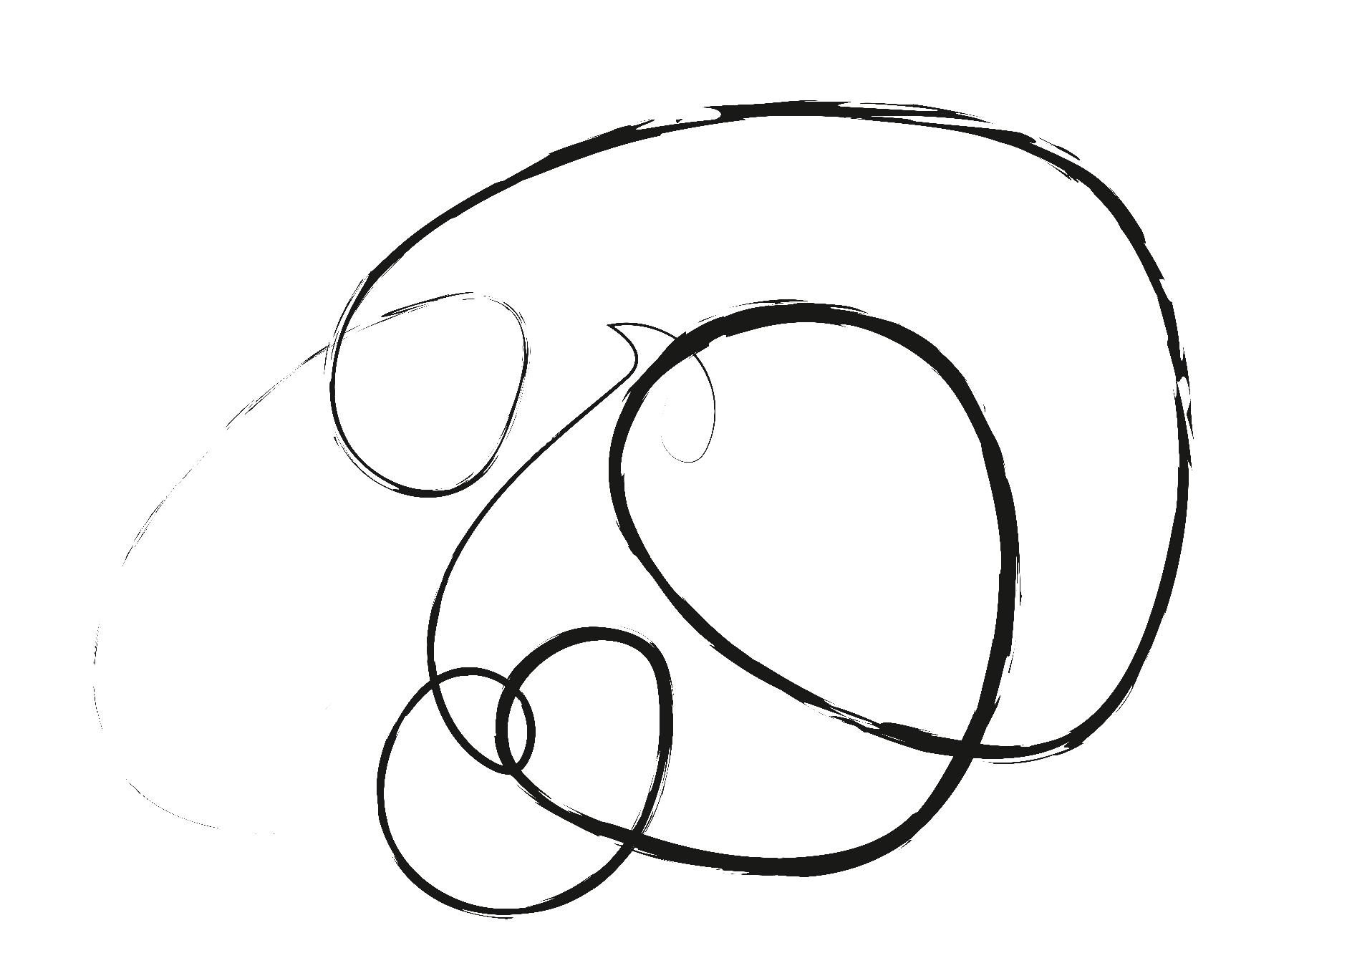


Main Philosophers of Existentialism
Here is where your presentation begins

Slide 2
Contents of this template
You can delete this slide when you’re done editing the presentation
Fonts | To view this template correctly in PowerPoint, download and install the fonts we used
Used and alternative resources | An assortment of graphic resources that are suitable for use in this presentation
Thanks slide | You must keep it so that proper credits for our design are given
Colors | All the colors used in this presentation
Icons and infographic resources | These can be used in the template, and their size and color can be edited
Editable presentation theme | You can edit the master slides easily. For more info, click here
For more info: Slidesgo | Blog | FAQs
You can visit our sister projects: Freepik | Flaticon | Storyset | Wepik | Videvo

Slide 3
Table of contents
01
02
03
04
05
06
Introduction
Theory and history
Key themes
You can describe the topic of the section here
You can describe the topic of the section here
You can describe the topic of the section here
Philosophers
Conclusions
Exercises
You can describe the topic of the section here
You can describe the topic of the section here
You can describe the topic of the section here

Slide 4

01
Introduction of Existentialism
You can enter a subtitle here if you need it

Slide 5

What is Existentialism?
Mercury is the closest planet to the Sun and the smallest one in the entire Solar System. This planet’s name has nothing to do with the liquid metal, since Mercury was named after the Roman messenger god. Despite being closer to the Sun than Venus, its temperatures aren’t as hot as that planet’s
Speaking of craters, many of them were named after artists or authors who made significant contributions to their respective fields. Mercury takes a little more than 58 days to complete its rotation, so try to imagine how long days must be there!

Slide 6

The influence of Existentialism
The arts and psychology
Mercury is the closest planet to the Sun and the smallest of them all
Philosophy
Venus has a beautiful name and is the second planet from the Sun

Slide 7

Existentialism theory
Do you know what helps you make your point crystal clear? Lists like this one:
They’re simple
You can organize your ideas clearly
You’ll never forget to buy milk!
And the most important thing: the audience won’t miss the point of your presentation

Slide 8
Types of existentialism
Christian
Atheistic
Absurdist
Mercury is the closest planet to the Sun and the smallest of them all
Venus has a beautiful name and is the second planet from the Sun
Despite being red, Mars is actually a cold place. It’s full of iron oxide dust

Slide 9
Four basic dimensions of human existence
The physical
The social
Mars is actually a cold place. It’s full of iron oxide dust
Venus has extremely high temperatures
The psychological
The spiritual
Jupiter is the biggest planet of them all
Saturn is a gas giant and has several rings

Slide 10
Key themes of existentialism
Alienation
Anxiety
Freedom
Mars is actually a very cold place
Venus has extremely high temperatures
Neptune is the farthest planet from the Sun
Authenticity
Absurdity
Death
Mercury is the closest planet to the Sun
Saturn is a gas giant with several rings
Jupiter is the biggest planet of them all

Slide 11
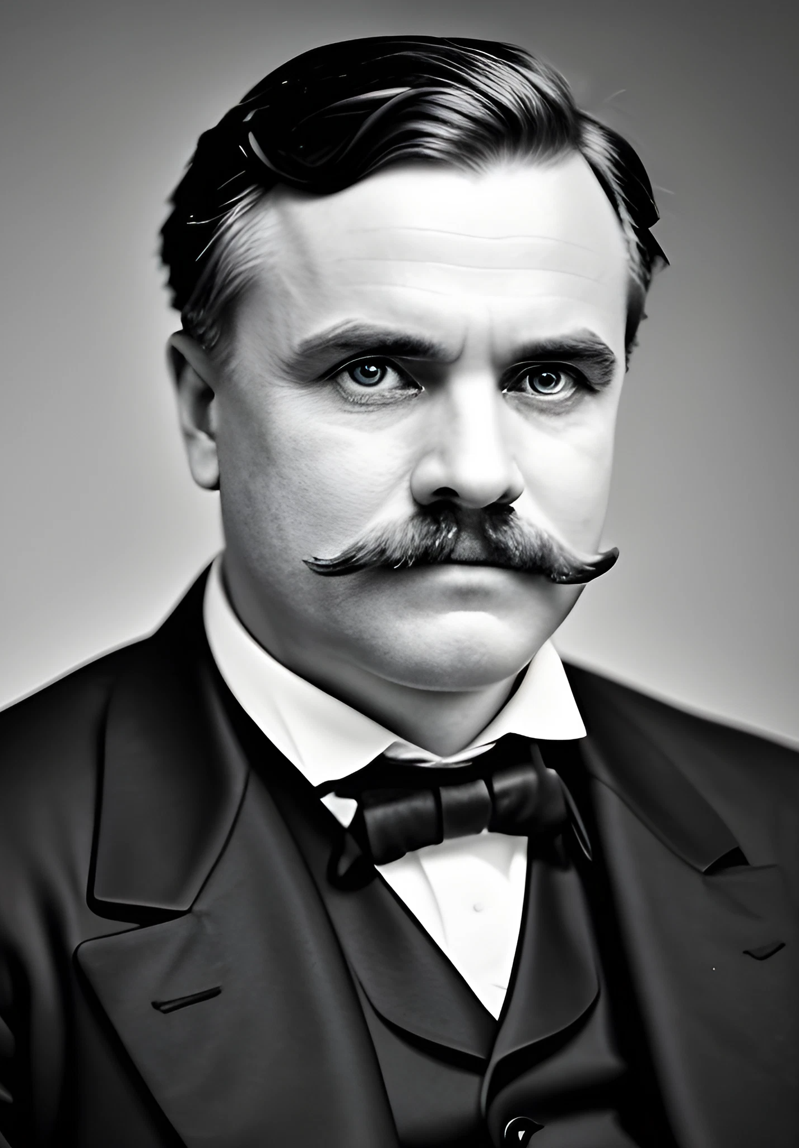
—Someone famous
“This is a quote, words full of wisdom that someone important said and can make the reader get inspired”

Slide 12
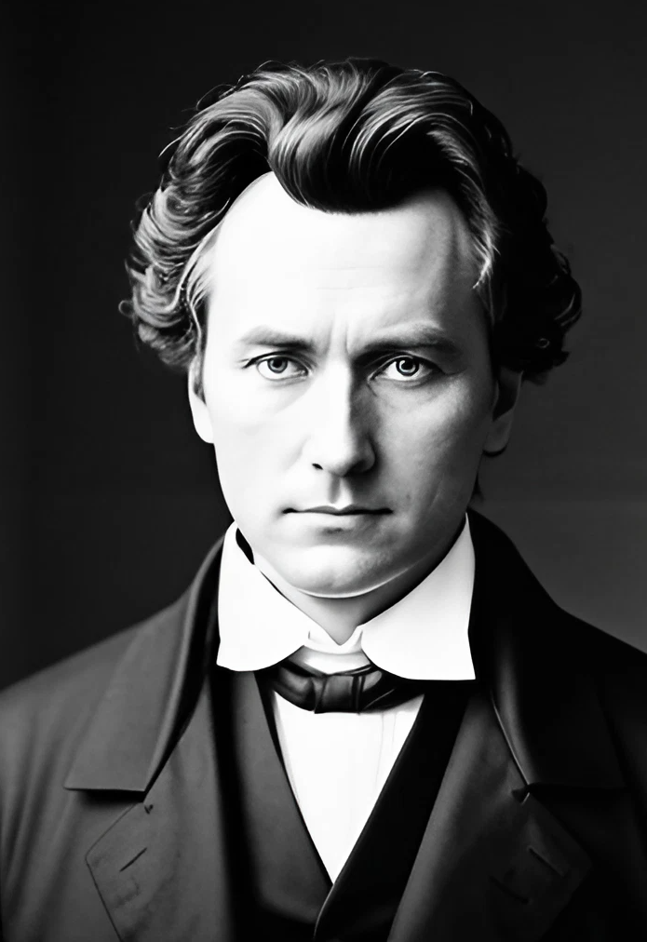
A pictures always reinforces the concept
Images reveal large amounts of data, so remember: use an image instead of a long text. Your audience will appreciate it

Slide 13
Existentialism core principles
40%
75%
30%
Phenomenology
Freedom
Authenticity
Mercury is the closest planet to the Sun and the smallest of them all
Venus has a beautiful name and is the second planet from the Sun
Despite being red, Mars is actually a cold place. It’s full of iron oxide dust

Slide 14
When and where did existentialism start?
19th Century
Mercury is the closest planet to the Sun and the smallest of them all
France
Despite being red, Mars is actually a cold place. It’s full of iron oxide dust

Slide 15
History of Existentialism
Earth
Jupiter
Earth is the planet with life
Jupiter is a huge gas giant
1810
1920
1960
Mercury
1850
Mars
1940
Saturn
Mercury is a small planet
Mars was named after a god
Saturn has several rings

Slide 16
Diagram of existence dimensions
Spiritual
Good / evil
Mars is actually a very cold place
Personal
Strength/weakness
Mercury is the closest planet to the Sun
Social
Life / death
Jupiter is the biggest planet of them all
Physical
Love / hate
Saturn is a gas giant with several rings

Slide 17
Existentialism vs Postmodernism
 | Existentialism | Postmodernism
The challenge | Finding meaning and value in a world without God | Unmasking the pretensions of reason
The method | Creation of meaning and value | Interpretation of the text of human experience
The danger | Nihilism: The surrender to despair in the face of the meaninglessness of existence | Oppression: The continued belief in narratives whose purpose is to support the dominant power structure

Slide 18
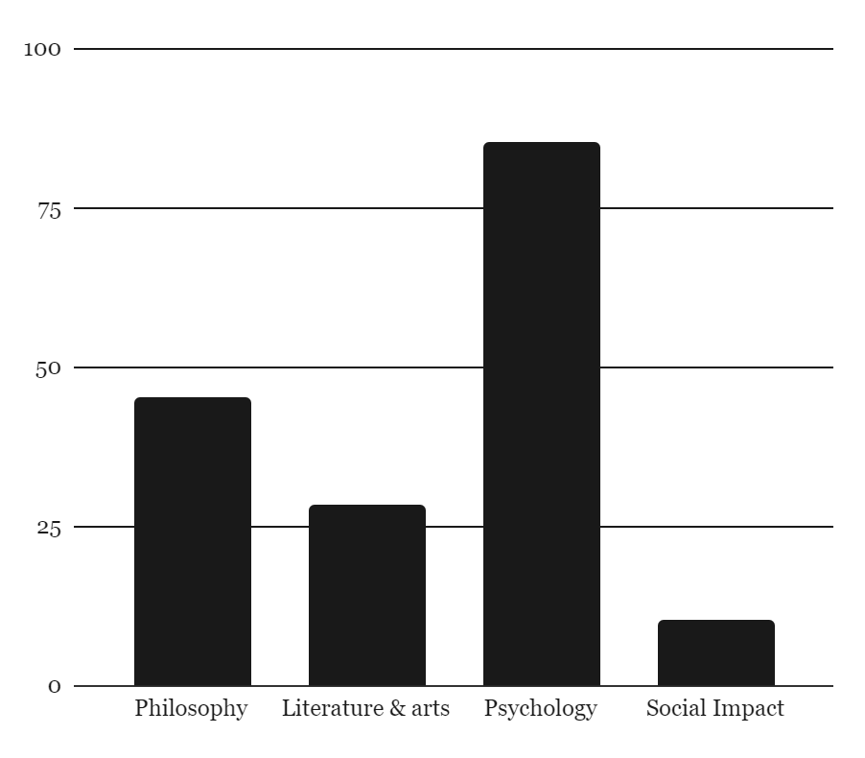
Impact of existentialism contributions
45%
85%
Philosophy
Psychology
Venus has extremely high temperatures
Neptune is the farthest planet from the Sun
28%
10%
Literature & arts
Social impact
Saturn is a gas giant with several rings
Jupiter is the biggest planet of them all
Follow the link in the graph to modify its data and then paste the new one here. For more info, click here

Slide 19
Existential crisis
Existential crisis
Absurdism
Nihilism
Authentic existence
Embrace the absurdity
Rejecting all meaning
Finding meaning
Camus
Nietzsche
Sartre, Kierkegaard

Slide 20
Reading plan
Book
Describe the theme
Saturn is the second-largest planet in the Solar System
Would you recommend it?
Neptune is the fourth-largest planet in the Solar System
Describe your favorite part
Venus has a beautiful name and is the second planet from the Sun. It’s terribly hot, even hotter than Mercury, and its atmosphere is extremely poisonous. It’s the second-brightest natural object in the night sky
Mercury
Author
Mars
Genre
Venus
Rating

Slide 21
Some philosophers of existentialism
Jean-Paul Sartre (1905 - 1980)
Friedrich Nietzsche (1844 - 1900)
Soren Kierkegaard (1813 - 1855)
Neptune is the fourth-largest planet in the Solar System
Venus is the second planet from the Sun
Saturn is the second-largest planet in the Solar System
Hannah Arendt (1889 - 1976)
Simone Weil
(1908 - 1986)
Despite being red, Mars is actually a cold place
Jupiter is a gas giant and has around eighty moons

Slide 22
Exercise 1: Complete the table
Directions: Complete the table with the correct information
Philosopher | Years of contribution | Notable contributions | Main ideas
Friedrich Nietzsche | Write here… | Explored nihilism, criticized traditional | Write here…
Simone de Beauvoir | 1940s-1980s | Write here… | The Other, gender roles, existentialism's
Jean-Paul Sartre | 1930s-1980s | Popularized existentialism, focused on radical | Radical freedom, existential angst,
Hannah Arendt | Write here… | Write here… | Write here…

Slide 23
Exercise 2: Match
Directions: Match the sentences with the correct philosopher
"Existence precedes essence."
Camus
"One is not born, but rather becomes, a woman."
Heidegger
"The absurd is the essential concept and the first truth."
Sartre
“Language is the house of Being."
Nietzsche
"He who has a why to live can bear almost any how."
Beauvoir

Slide 24
Exercise 3: true or false
Directions: Say the following sentences are true or false:
 | T | F
Existentialism is a philosophical movement that emphasizes individual existence, freedom, and choice
Kierkegaard believed that faith and reason are entirely compatible and can be reconciled through systematic philosophical arguments
Existentialism asserts that the only way to find meaning in life is through organized religion and following established moral codes
Jean-Paul Sartre is often considered one of the key figures in the existentialist movement

Slide 25
Conclusion
Despite being red, Mars is actually a cold place. It’s full of iron oxide dust, which gives the planet its reddish cast

Slide 26
Thanks!
Do you have any questions?
youremail@freepik.com
+34 654 321 432
yourwebsite.com
Please keep this slide for attribution

